Slide 1


2018 Commercial Buildings Energy Consumption Survey
Building Characteristics Highlights
#CBECS | www.eia.gov/cbecs

Slide 2
2018 Commercial Buildings Energy Consumption Survey
Building Characteristics Highlights
Released September 2021
Revised September 2022
U.S. Energy Information Administration
Office of Energy Statistics
U.S. Department of Energy
Washington, DC 20585
This publication is available at:
https://www.eia.gov/cbecs
  This report was prepared by the U.S. Energy Information Administration (EIA), the statistical and analytical agency within the U.S. Department of Energy. By law, EIA's data and analyses are independent of approval by any other officer or employee of the United States Government. The views in this report therefore should not be construed as representing those of the U.S. Department of Energy or other federal agencies.

Slide 3

What is the Commercial Building Energy Consumption Survey (CBECS)?
CBECS is:
The only independent, statistically representative source of national-level data on the characteristics and energy use of commercial buildings
A snapshot of the commercial buildings stock and energy use for the reference year—in this case, 2018
A sample survey where every commercial building has a known chance of being selected
The U.S. Energy Information Administration (EIA) collects data for commercial buildings in two parts:
We collect building characteristics through an in-person or web survey. Respondents, such as building owners and managers, completed the survey at 6,436 buildings for the 2018 CBECS, representing 5.9 million buildings in the United States.
We collect energy usage data from suppliers of electricity, natural gas, fuel oil, and district heat.
We have conducted the CBECS periodically since 1979, as required by Congress.
The 2018 CBECS is the 11th iteration.

Slide 4
Key takeaways from EIA’s 2018 CBECS building characteristics results
Growth in building size continued to outpace increases in building stock; from 2003 to 2018, the number of buildings increased by 22% and total floorspace by 35%.
Newer buildings were larger, on average, than older commercial buildings.
Warehouse and storage, office, and service buildings were the most common building types.
Building types with the largest percentage increase in the number of buildings since 2012 were service, public assembly, lodging, and warehouse and storage.
Shares of commercial buildings, commercial floorspace, and the U.S. population were highest in the South Census Region.
Natural gas was the most common space heating energy source, and electricity was the most commonly used energy source overall.
Out of all types of lighting equipment, only LED lighting use increased since 2012.
An estimated 2% of commercial buildings had electric vehicle charging stations.
Note: These data are for reference year 2018 and do not reflect the impact of the COVID-19 pandemic. All data referenced in this document is available in the CBECS building characteristics tables. These data supersede the 2018 preliminary data previously published. Unless otherwise noted, all differences are statistically significant at the 10% significance level or lower. A lower significance level indicates a lower likelihood of incorrectly concluding a difference exists between two values when no difference actually exists.

Slide 5
Table of contents | Slide number
Buildings and floorspace | 6
Principal building activity | 11
Year of construction | 17
Regional estimates | 21
Energy sources and end uses | 25
Energy-related building features | 33
References and additional information | 38

Slide 6
Buildings and Floorspace
The CBECS includes buildings larger than 1,000 square feet for which more than half the floorspace is used for activities that are neither residential, manufacturing, industrial, nor agricultural.

Slide 7

Growth in building size outpaced increases in building stock
Number of commercial buildings and floorspace, 1979–2018
number of buildings (millions) and billion square feet
number of buildings (millions)
billion square feet
CBECS estimates that there were 5.9 million buildings and 96 billion square feet of total commercial floorspace in 2018.
The CBECS estimates that over 15 years (from 2003 to 2018), the total number of buildings increased by 22% and total floorspace increased by 35%.
Total square footage increased by 11% from 2012 to 2018. The increase in number of buildings from 2012 to 2018 was not statistically significant.
From the first CBECS in 1979 to the 2018 CBECS, the number of buildings has increased from 3.8 million to 5.9 million (56%), and the amount of commercial floorspace has increased from 51 billion square feet to 96 billion square feet (89%).
total commercial floorspace
number of commercial buildings
Source: U.S. Energy Information Administration, Commercial Buildings Energy Consumption Survey

Slide 8
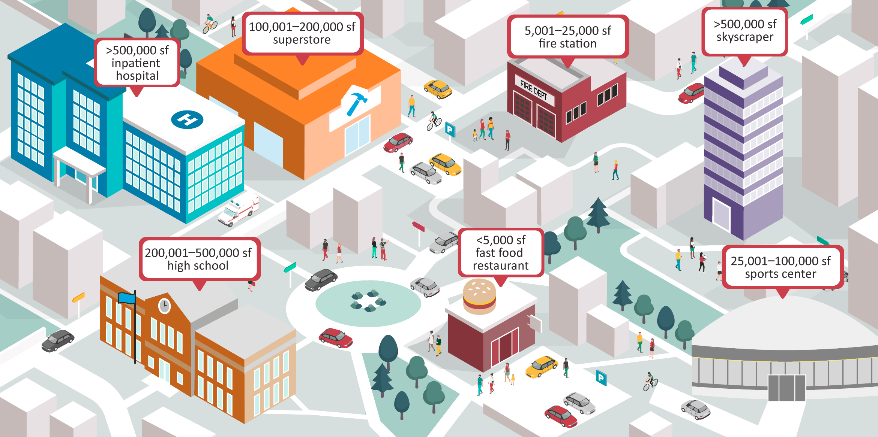
Typical building size category illustrations square feet (sf)

Slide 9
Most buildings were small, but large buildings dominated total floorspace
Total commercial buildings and floorspace by square footage category, 2018
percentage
The smallest buildings (1,001 square feet [sf] to 5,000 sf) accounted for almost half of all commercial buildings, but they occupied only 8% of total commercial floorspace.
Nearly three-fourths (71%) of buildings were 10,000 sf or smaller.
Buildings larger than 100,000 sf accounted for less than 3% of commercial buildings but 34% of commercial floorspace.
The median building size was 5,400 sf; the average building size was 16,300 sf.
percentage of total commercial buildings
percentage of total commercial floorspace
Source: U.S. Energy Information Administration, Commercial Buildings Energy Consumption Survey

Slide 10
Building size increased with more average floorspace per worker
Average square feet per worker, all buildings and office buildings, 1995–2018
square feet
all buildings office buildings
Total main shift workers in commercial buildings increased by 12%, from 77 million workers in 1995 to 86 million workers in 2018.
CBECS estimates that the average square feet per worker in commercial buildings in 2018 was 1,072 sf, a 40% increase from 1995.
Although office buildings had the most workers, the square feet per worker was much lower for offices than the average for all building types. On average, office workers had 507 sf of floorspace. In 1995, the average floorspace for workers in offices was 387 sf.
Building types that serve the public likely have many more occupants than workers; religious worship, lodging, and public assembly all had an average of more than 2,000 square feet per worker.
Buildings with the largest square feet per worker, 2018
religious worship
2,656 sf
2,767 sf
lodging
2,431 sf
2,291 sf
warehouse and storage
2,222 sf
2,214 sf
public assembly
2,082 sf
2,075 sf
Source: U.S. Energy Information Administration, Commercial Buildings Energy Consumption Survey

Slide 11

Principal Building Activity
The principal building activity is the activity or function that occupies the most floorspace in a building. EIA designed the following principal building activity categories to group buildings that have similar patterns of energy consumption:
      Visit Building Type Definitions on the CBECS web page to learn more about these principal building activities.
Education Food sales Food service Health care Lodging | Mercantile Office Public assembly Public order and safety Religious worship | Service Warehouse and storage Other Vacant

Slide 12
Warehouse and storage, office, and service buildings were the most common building types
Percentage of commercial buildings and floorspace by principal building activity, 2018
health care
food service
food sales
public order and safety
vacant
other
lodging
health care
food sales
public order and safety
vacant
other
all other buildings, 12%
warehouse and
storage, 17%
all other buildings, 15%
warehouse and
storage, 18%
food service, 5%
lodging, 7%
5.9 million
number of buildings
education, 7%
96.4 billion
total floorspace
in square feet
office, 16%
office, 17%
education, 14%
religious worship, 7%
public assembly, 8%
service, 6%
religious worship, 6%
service, 15%
mercantile, 9%
mercantile, 11%
public assembly, 7%
Source: U.S. Energy Information Administration, Commercial Buildings Energy Consumption Survey
Warehouse and storage, office, and service buildings together accounted for 48% of all commercial buildings and 42% of total commercial building floorspace.
Although service buildings were the third most common building type, these buildings accounted for only 6% of total floorspace. Education buildings accounted for 7% of all buildings, but they accounted for 14% of total floorspace.
Although food service buildings accounted for 5% of all commercial buildings, they accounted for only 1% of total floorspace. Lodging buildings accounted for 4% of commercial buildings, but they accounted for 7% of total floorspace.

Slide 13
Many principal building activities increased in the number of buildings from 2012 to 2018
Number of commercial buildings by principal building activity, 2018
thousands
The largest percentage increases in the number of buildings were for service (40%), public assembly (39%), lodging (31%), and warehouse and storage (26%).
The largest percentage decreases in the number of buildings were for vacant (30%) and food service (25%).
2012
2018
Source: U.S. Energy Information Administration, Commercial Buildings Energy Consumption Survey
* Change is statistically significant at the 10% significance level.
** Change is statistically significant at the 5% significance level.

Slide 14
Buildings used for lodging were the largest, and buildings used for food service were the smallest
Average floorspace by principal building activity, 2018
square feet per building
On average, among the principal building activities, lodging (33,700 sf), education (31,100 sf), and health care (29,300 sf) were the largest buildings.
The size of inpatient health care buildings (hospitals) contributes greatly to the health care category’s average floorspace. Hospitals averaged 264,800 sf per building, compared with outpatient health care buildings, which averaged 13,700 sf.
On average, food service buildings were the smallest (4,800 sf), followed by food sales, service, and vacant.
Source: U.S. Energy Information Administration, Commercial Buildings Energy Consumption Survey

Slide 15
Office and education buildings had the most workers
Number of main shift workers and buildings by principal building activity, 2018
percentage
Half of all main shift workers worked in office and education buildings in 2018.
Although health care buildings accounted for 2% of commercial buildings, health care workers accounted for 8% of all main shift workers.
percentage of main shift workers
percentage of buildings
Source: U.S. Energy Information Administration, Commercial Buildings Energy Consumption Survey

Slide 16
Lodging buildings operated the most hours per week
Average weekly operating hours in commercial buildings by principal building activity, 2018
hours
On average, lodging (165 hours), public order and safety (131 hours), and food sales (110 hours) buildings operated the most hours per week.
The proportion of lodging buildings that were open continuously contributes greatly to the average operating hours per week. Almost all lodging buildings were open continuously (98%).
Religious worship, and vacant buildings were open less than 50 hours per week on average.
Percentage of buildings open continuously
all buildings
12%
lodging
98%
public order and safety
74%
Source: U.S. Energy Information Administration, Commercial Buildings Energy Consumption Survey

Slide 17
Year of Construction
The year of construction is the year in which the major part or the largest portion of a building was constructed.

Slide 18
More than half of U.S. commercial buildings were built between 1960 and 1999
Share of number of buildings and floorspace by year constructed, 2018
percentage of total for all buildings
Buildings built between 1960 and 1999 accounted for more than 50% of both total number of buildings and of floorspace.
One-quarter of buildings (25%) were built after 2000, accounting for 29% of total floorspace.
Buildings built before 1960 represented 21% of buildings but only 17% of total floorspace.
The median year of construction was 1981.
1990–1999
1980–1989
2010–2018
1970–1979
1946–1959
1920–1945
1960–1969
2000–2009
before 1920
buildings
floorspace
buildings
floorspace
buildings
floorspace
before 1960
1960 to 1999
2000 to 2018
Source: U.S. Energy Information Administration, Commercial Buildings Energy Consumption Survey

Slide 19
Newer buildings were larger, on average, than older commercial buildings
Average building size by year of construction, 2018
square feet
2000 to 2018
average: 19,000 square feet
Buildings constructed before 1960 are smaller than buildings constructed since 2000—more than 5,000 square feet smaller, on average.
Buildings constructed since 2000 averaged 19,000 square feet, or 2,700 square feet larger than the national average.
1960 to 1999
average: 16,300 square feet
before 1960
average: 13,200 square feet
Source: U.S. Energy Information Administration, Commercial Buildings Energy Consumption Survey

Slide 20
More than a third of lodging and health care buildings were constructed since 2000
Proportion of commercial buildings by year of construction and
principal building activity, 2018
percentage
More than 30% of health care, lodging, and public order and safety buildings were constructed since 2000.
More than 30% of food service, religious worship, and vacant buildings were constructed before 1960.
before 1960
1960 to 1999
2000 to 2018
Source: U.S. Energy Information Administration, Commercial Buildings Energy Consumption Survey

Slide 21
Regional Estimates
In addition to national estimates, CBECS estimates building characteristics by census region and division.

Slide 22
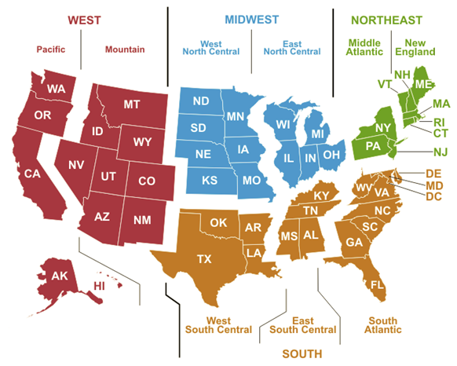
U.S. census regions and divisions

Slide 23
Commercial buildings, floorspace, and population were highest in the South
Commercial buildings, floorspace, and U.S. population by region, 2018
percentage
buildings
floorspace
2018 U.S. population
More than one-third of the U.S. population (38%), buildings (36%), and floorspace (36%) were in the South.
The Midwest was the only region with a smaller share of the total U.S. population than of buildings. It had the second-highest share of buildings (29%) and floorspace (27%) but had the third-highest share of the U.S. population (21%).
The West had nearly one-fourth of the U.S. population (24%) and about one-fifth of buildings (21%) and floorspace (20%).
Source: U.S. Energy Information Administration, Commercial Buildings Energy Consumption Survey; U.S. Census Bureau, Population Estimates Program, based on one-year estimates from the American Community Survey.
Note: Population estimates are as of July 1, 2018.

Slide 24
Commercial buildings were largest in the Middle Atlantic
Average square feet per building by census division, 2018
thousands
Northeast
average: 20,100 square feet
Commercial buildings in the Middle Atlantic Census Division averaged 23,600 square feet (sf), 45% more than the average for all U.S. buildings (16,300 sf) in 2018.
Commercial buildings were among the smallest on average (13,600 sf) in New England and brought the average building size for the entire Northeast region down to 20,100 square feet, which was 23% more than the national average floorspace.
Midwest
average: 15,100 square feet
South
average: 16,300 square feet
West
average: 15,500 square feet
national average: 16,300 square feet
Source: U.S. Energy Information Administration, Commercial Buildings Energy Consumption Survey

Slide 25
Energy Sources and End Uses
An energy source is a type of energy or fuel consumed in a building. In the CBECS, we obtained information about the use of electricity, natural gas, fuel oil, district heat, district chilled water, propane, wood, coal, and solar in commercial buildings from the building respondent.
An energy end use is a use for which energy is consumed in a building. We collected information on seven specific end uses in the CBECS—space heating, cooling, water heating, cooking, manufacturing, electricity generation, and lighting.

Slide 26
Although electricity was most common, other sources are also used in commercial buildings
Total commercial buildings and floorspace by energy source, 2018
percentage
Electricity was the most commonly used energy source in commercial buildings. It was used in 95% of buildings, which accounted for 98% of total floorspace.
Half of commercial buildings and more than two-thirds of floorspace (70%) used natural gas.
percentage of total commercial buildings
percentage of total commercial floorspace
Source: U.S. Energy Information Administration, Commercial Buildings Energy Consumption Survey

Slide 27
Four end uses were common among more than three-fourths of commercial buildings
Percentage of commercial buildings and floorspace by end use, 2018
space heating
water heating
electricity generation
Lighting, space heating, cooling, and water heating were each used in more than three-fourths of commercial buildings, accounting for at least 90% of total floorspace.
Electricity generation was more common in larger buildings. Buildings with electricity generation averaged 41,700 square feet, more than twice the size of the average building.
lighting
cooling
cooking
manufacturing
number of buildings
total
floorspace
Source: U.S. Energy Information Administration, Commercial Buildings Energy Consumption Survey

Slide 28
Natural gas was used most for space heating; electricity was used most for cooling
Commercial building space heating and primary heating by energy source, 2018
percentage of buildings
Commercial building cooling by energy source, 2018
percentage of buildings
any space heating
primary space heating
Source: U.S. Energy Information Administration, Commercial Buildings Energy Consumption Survey
Note: For any space heating, more than one heating energy source may apply. Other sources include wood, coal, solar, and all other energy sources.
Source: U.S. Energy Information Administration, Commercial Buildings Energy Consumption Survey
For space heating, natural gas (44%) or electricity (43%) were used in the majority of commercial buildings.
More than three-fourths (78%) of commercial buildings were cooled using electricity.

Slide 29
Space heating energy sources varied by region
Commercial building heating by region and energy source, 2018
percentage of buildings
Electricity use for space heating was highest in the South (55%), but natural gas use for space heating was lowest in the South (33%).
The Northeast had the largest percentage of buildings using fuel oil for space heating (23%).
Although 9% of buildings in the Northeast used propane for space heating, in particular, 22% of buildings in the New England Census Division were heated by propane.
District heat use was 4% or less in each region.
electricity
natural gas
fuel oil
district heat
propane
Q
Q
Source: U.S. Energy Information Administration, Commercial Buildings Energy Consumption Survey
Note: More than one energy source may apply.
Q = Data withheld either because the Relative Standard Error (RSE) was greater than 50 percent or fewer than 20 buildings were sampled.

Slide 30
Packaged heating units and furnaces were the most commonly used heating equipment
Total commercial buildings and floorspace by heating equipment, 2018
percentage
Average building size by heating equipment
Packaged heating units were used in 37% of buildings, or 50% of total floorspace.
Furnaces were used in 27% of buildings, but these buildings only accounted for 18% of total floorspace.
Although boilers were used in only 12% of buildings, these buildings accounted for 30% of total floorspace.
22,000 sf
10,700 sf
17,000 sf
41,000 sf
22,400 sf
55,200 sf
percentage of total commercial buildings
percentage of total commercial floorspace
79,300 sf
Source: U.S. Energy Information Administration, Commercial Buildings Energy Consumption Survey
Note: More than one type of heating equipment may apply.

Slide 31
Packaged air-conditioning units cool more than half of commercial floorspace
Total commercial buildings and floorspace by cooling equipment, 2018
percentage
Average building size by cooling equipment
Packaged air-conditioning units were used in 43% of buildings, or 58% of total floorspace.
Residential-type central air conditioners were used in 22% of buildings, but these buildings only account for 19% of total floorspace.
Although central chillers were used in only 3% of buildings, these buildings account for 19% of total floorspace.
21,900 sf
14,000 sf
18,500 sf
22,500 sf
88,800 sf
24,500 sf
77,500 sf
percentage of total commercial buildings
percentage of total commercial floorspace
Source: U.S. Energy Information Administration, Commercial Buildings Energy Consumption Survey
Note: More than one type of cooling equipment may apply.

Slide 32
Out of all types of lighting equipment, only LED lighting use increased since 2012
Lighting equipment used in commercial buildings by bulb type, 2018
percentage of buildings
incandescent
Standard fluorescent lighting was used in 68% of buildings, falling from 84% in 2012.
The percentage of commercial buildings that used LED lighting increased from 9% in 2012 to 44% in 2018.
Aside from LED, all other bulb types decreased in usage between 2012 and 2018.
standard
fluorescent
compact
fluorescent
high-intensity
discharge (HID)
halogen
LED
2012
2018
Source: U.S. Energy Information Administration, Commercial Buildings Energy Consumption Survey
Note: More than one bulb type may apply. All changes from 2012 to 2018 were statistically significant at the 5% significance level.

Slide 33
Energy-Related Building Features
CBECS collects data on items such as ventilation systems, temperature controls for HVAC, window properties, lighting features, and technologies such as electricity generation and electric vehicle charging.

Slide 34
More than half of commercial buildings performed regular HVAC maintenance
Total commercial buildings and floorspace by HVAC features, 2018
percentage
Regular HVAC maintenance was used in 60% of commercial buildings, or 81% of floorspace.
Although programmable thermostat use was the second-most common HVAC feature (26% of buildings), it accounted for only 22% of floorspace.
We collected data about the presence of internet-connected (smart) thermostats for the first time in the 2018 CBECS. We estimate that 5% of buildings used smart thermostats.
percentage of total commercial buildings
percentage of total commercial floorspace
Source: U.S. Energy Information Administration, Commercial Buildings Energy Consumption Survey
Note: More than one HVAC feature may apply.

Slide 35
The most common window and lighting features were multipaned windows and occupancy sensors
Total commercial buildings and floorspace by window and interior lighting features, 2018
percentage
window features
Multipaned windows were used in 60% of buildings, which accounted for 75% of commercial floorspace.
Occupancy sensors, the most commonly used lighting feature, were used in 17% of buildings, which accounted for 46% of floorspace.
lighting features
percentage of total commercial buildings
percentage of total commercial floorspace
Source: U.S. Energy Information Administration, Commercial Buildings Energy Consumption Survey
Note: More than one window or lighting feature may apply. See the CBECS Terminology for definitions of terms used.

Slide 36
Half of public order and safety buildings used electricity generation technologies
Electricity generation in commercial buildings by principal building activity, 2018
percentage of buildings
Electricity generation technologies include solar panels, reciprocating engine generators, and other technologies. These technologies may generate electricity all the time, during times of peak demand, or only for backup emergency use.
Most of the electricity generation in public order and safety buildings was from reciprocating engine generators.
Although 22% of health care buildings overall had electricity generation, 100% of inpatient health care buildings had electricity generation capabilities.
The activities most likely to have solar panels were public assembly (3% of buildings, or 8% of floorspace) and education (3% of buildings, or 6% of floorspace).
public order and safety
other
lodging
office
health care
education
public assembly
service
all buildings
food sales
mercantile
warehouse and storage
religious worship
Source: U.S. Energy Information Administration, Commercial Buildings Energy Consumption Survey
Note: Data was not sufficient to produce estimates for food service and vacant buildings.

Slide 37
New question provides insight on the prevalence of electric vehicle (EV) charging stations
Percentage of commercial buildings with EV charging stations by square footage category, 2018
Percentage of commercial buildings with EV charging stations by select principal building activity, 2018
Source: U.S. Energy Information Administration, Commercial Buildings Energy Consumption Survey
Source: U.S. Energy Information Administration, Commercial Buildings Energy Consumption Survey
The CBECS estimates that 2% of commercial buildings had EV charging stations.
Lodging and service buildings were building types most likely to have EV charging, and the larger the building, the more likely it was to have EV charging. More than one-third (36%) of buildings over 500,000 sf reported having EV charging stations.

Slide 38
References and Additional Information

Slide 39
Additional CBECS information
2018 building characteristics tables
  https://www.eia.gov/consumption/commercial/data/2018/index.php?view=characteristics
Guide to the tables
https://www.eia.gov/consumption/commercial/data/2018/guide.php
CBECS terminology
https://www.eia.gov/consumption/commercial/terminology.php
CBECS building type definitions
https://www.eia.gov/consumption/commercial/building-type-definitions.php
Frequently asked questions (FAQs)
https://www.eia.gov/consumption/commercial/faq.php

Slide 40
For more information
U.S. Energy Information Administration homepage | www.eia.gov
Commercial Buildings Energy Consumption Survey | www.eia.gov/cbecs
Today in Energy | www.eia.gov/todayinenergy

